Slide 1
Computer Network Security
TE - IT
Lecture -22
14/09/2022
Session: 9:45 - 10:45 AM
Prof. Stella J
Department of Information Technology
Xavier Institute of Engineering

Slide 2
Module-4
1. VPN Technology
2. Types of VPN

Slide 3
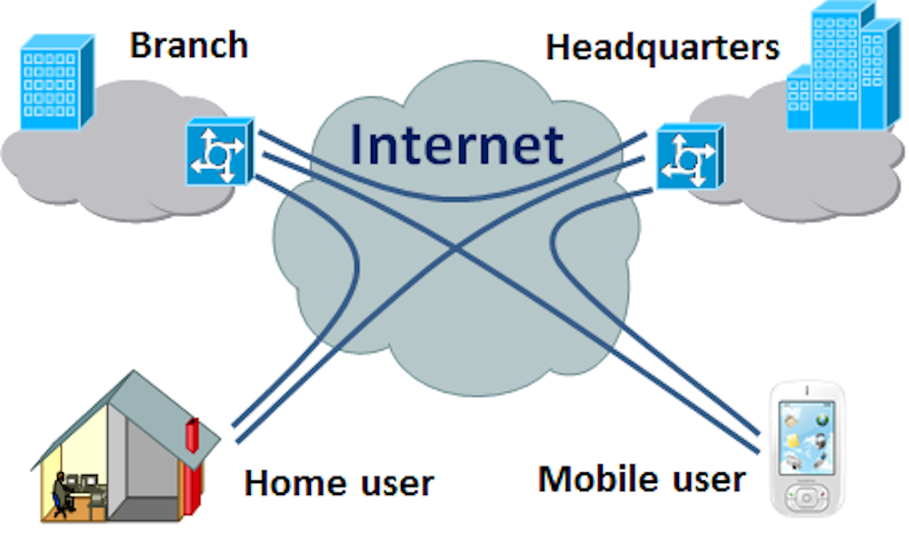
VPN Technology
Virtual Private networks create end to end private network connections.
A VPN is virtual in that it carries information within a private network, but that information is actually transported over a public network.
A VPN is private in that the traffic is encrypted to keep the data confidential while it is transported across the public network

Slide 4
VPN Technology
VPN Benifits:
Modern VPN supports encryption features such as Internet Protocol Security and SSL VPN to secure network traffic between sites.
Major Benifits are,
1. Scalability
2. Cost
3. Security
4. Compatability

Slide 5
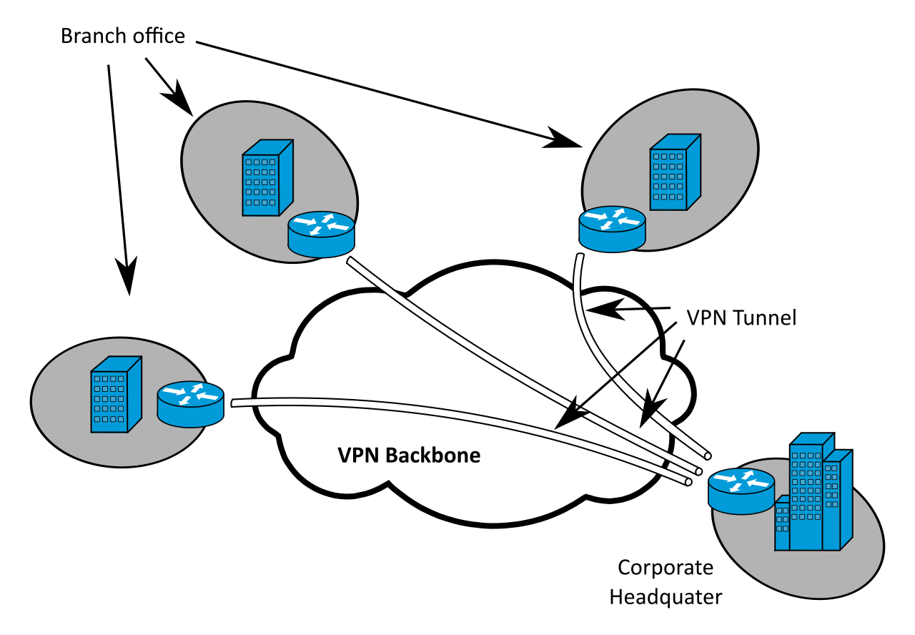
VPN Technology
Site to Site VPN’s:
A site to site VPN is terminated on VPN gateways. VPN traffic only encrypted between the gateways. Internal hosts have no knowledge that a VPN is being used.

Slide 6
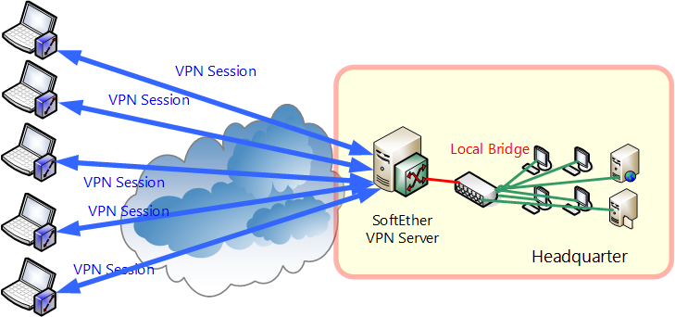
VPN Technology
Remote access VPN’s:
A remote access VPN is dynamically created to establish a secure connection between a client and a VPN terminating device.

Slide 7
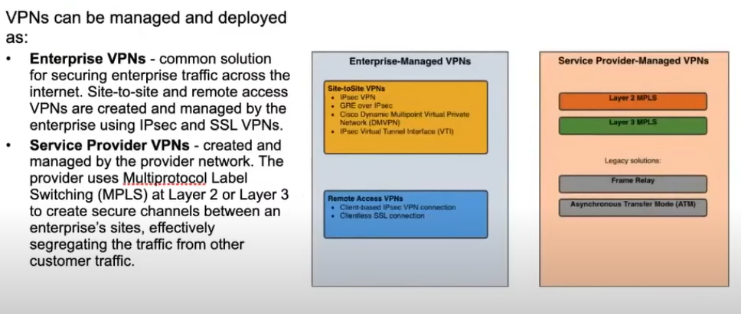
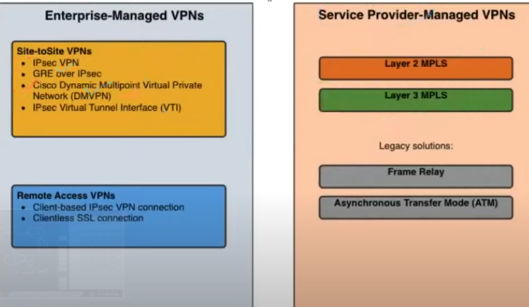
VPN Technology

Slide 8
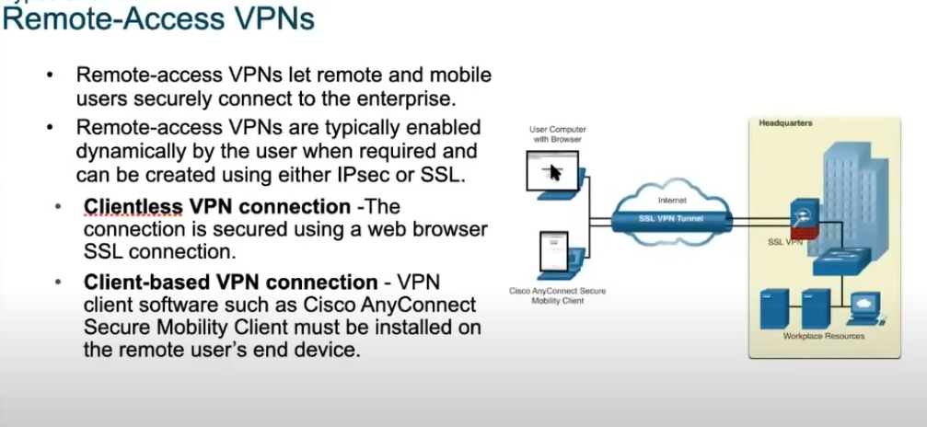
VPN Technology

Slide 9
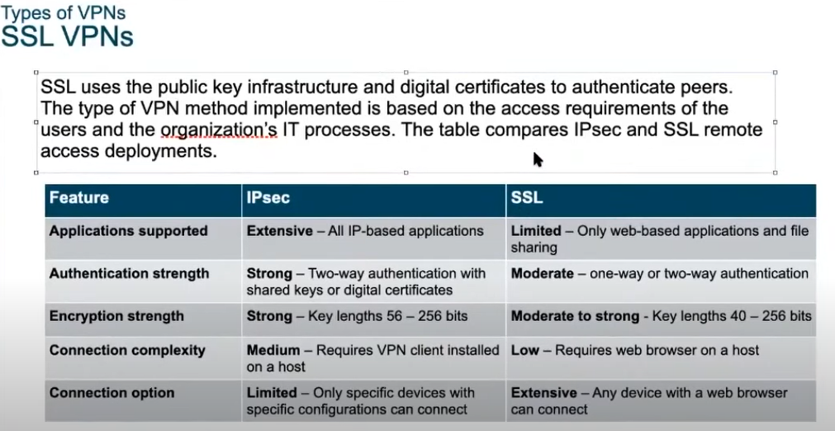
VPN Technology

Slide 10
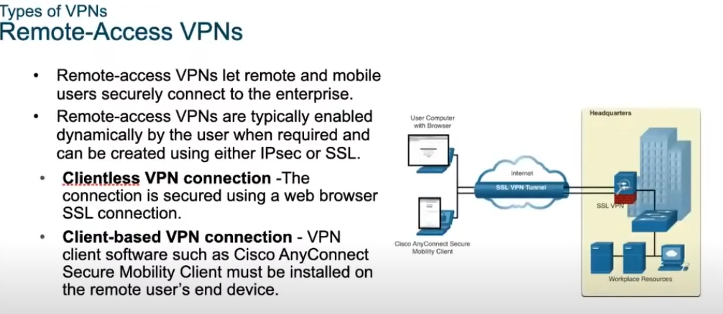

Slide 11
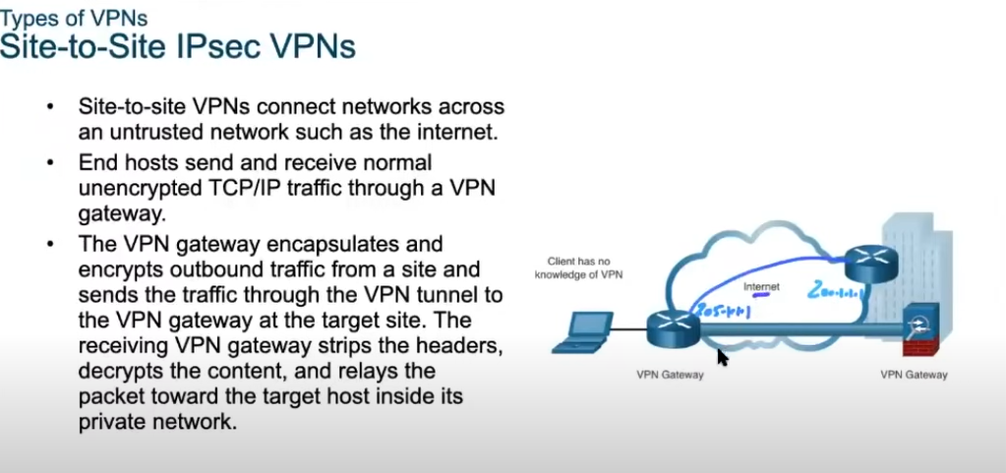

Slide 12
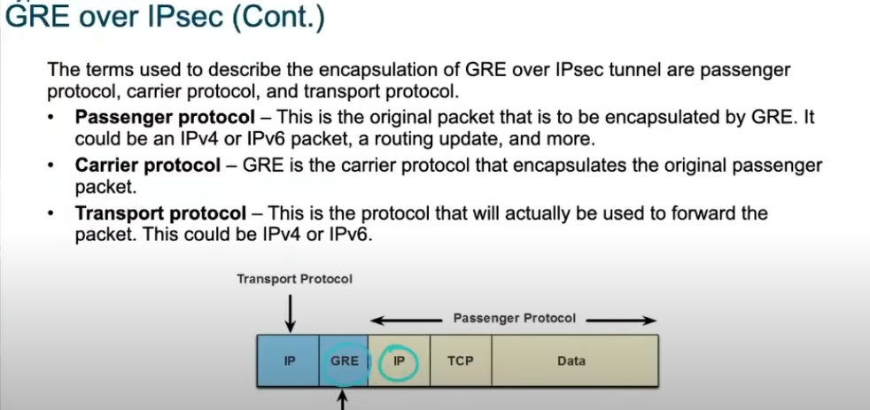
VPN Technology

Slide 13
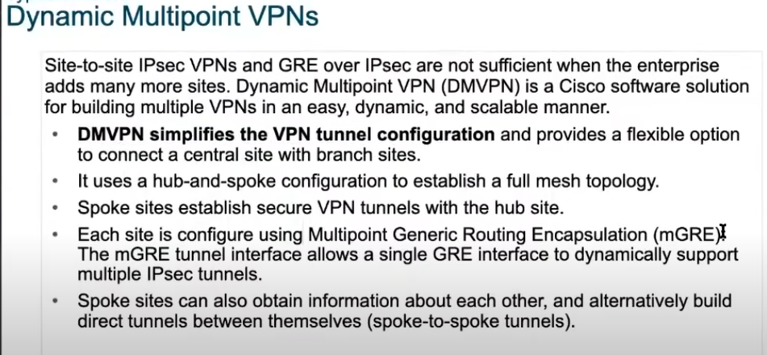
VPN Technology

Slide 14
THANK YOU

